Slide 1
FOURda Code!

Slide 2




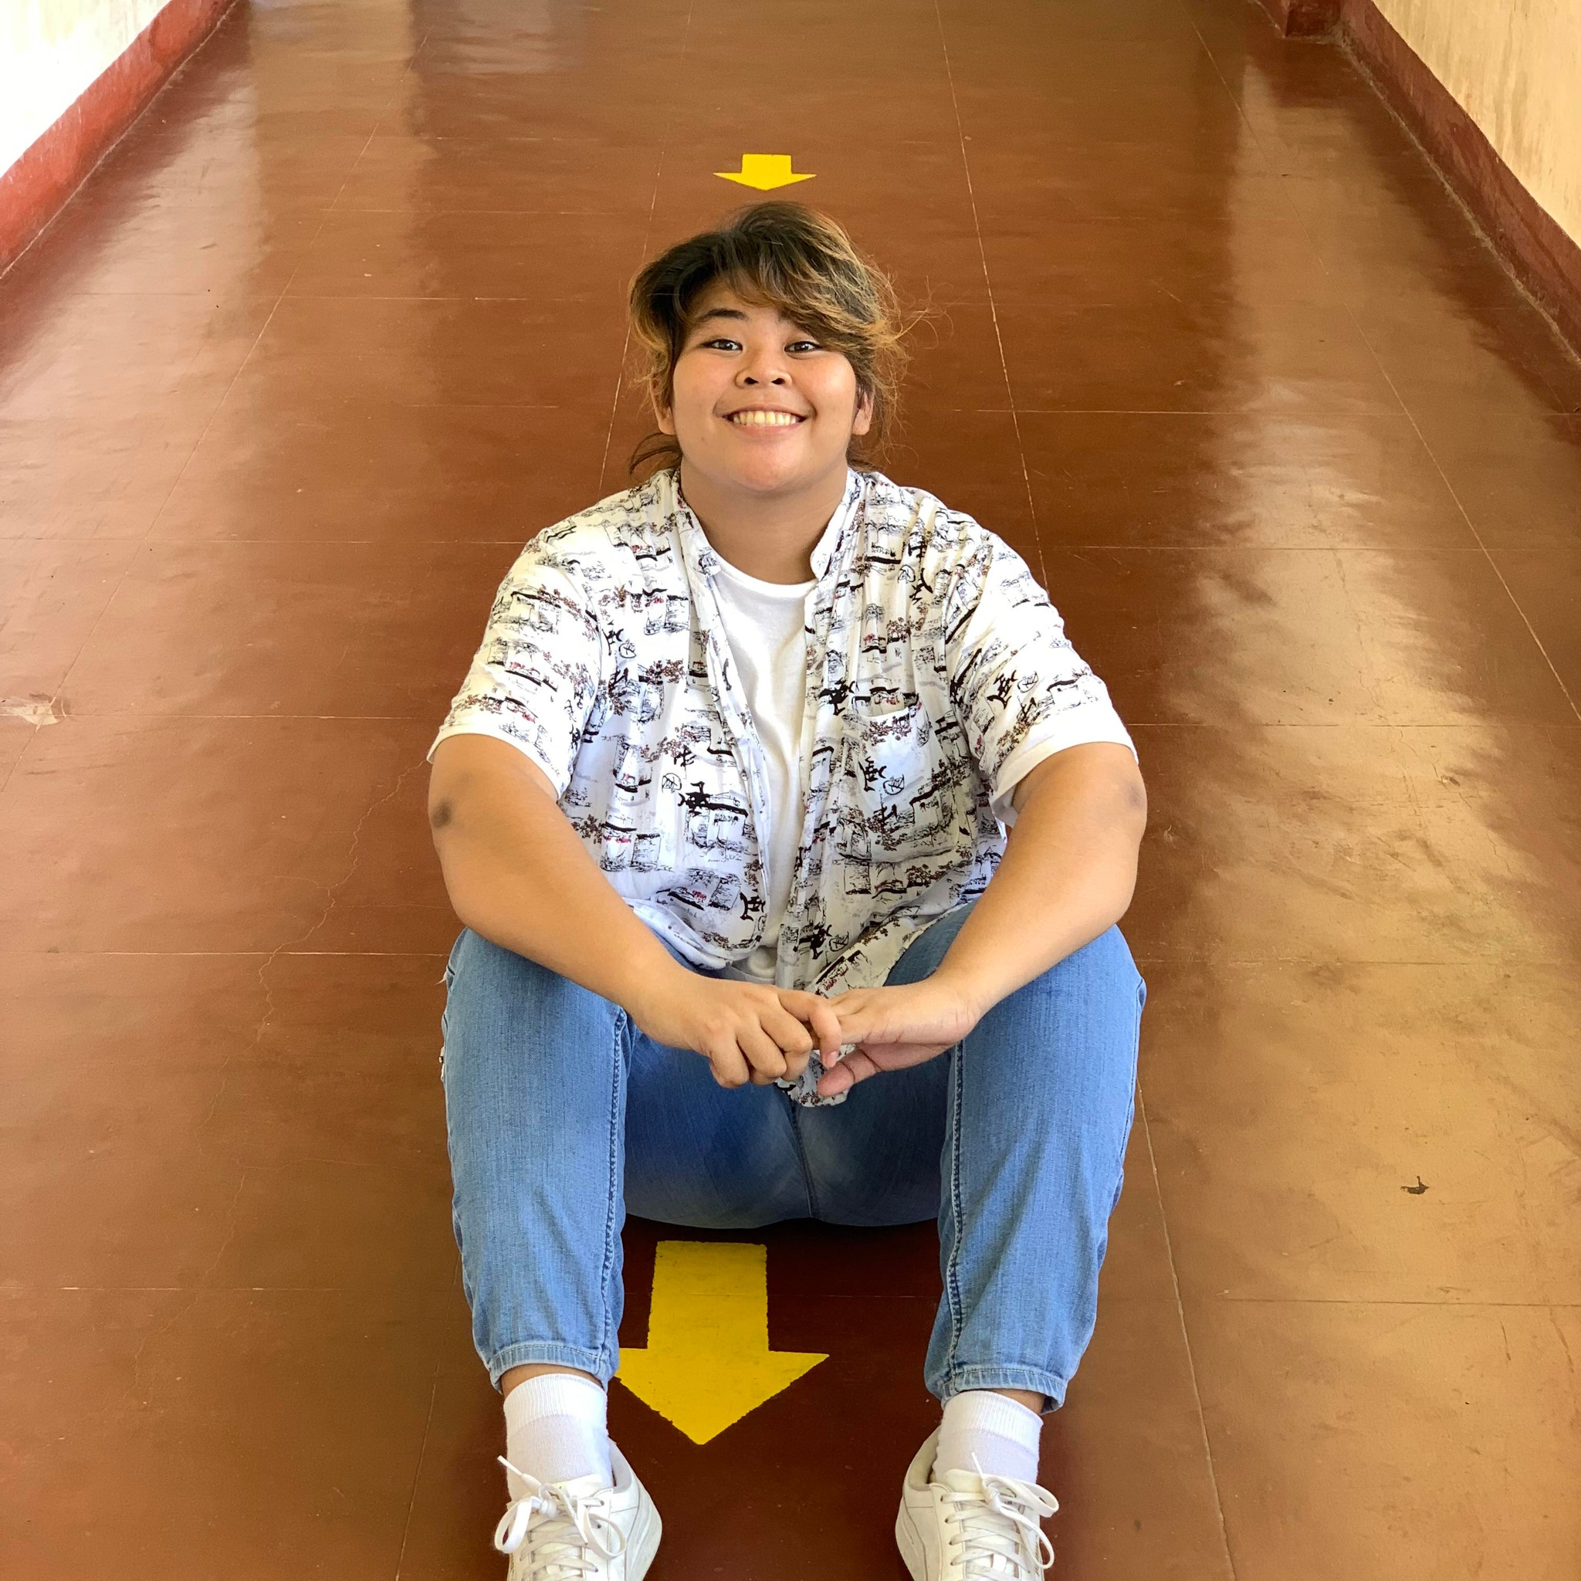
Rose Bianca Pano
Jogie Otic
Dante Baldonado
Feliza Dia

Slide 3
Athena Perb’s Catering Services:
A POS and Inventory
Software-based System

Slide 4
PROBLEM STATEMENT:
WHY BUILD THIS KIND OF SYSTEM?
To help Athena Pherb’s Catering Services to record their transactions since they are having a hard time computing their sales.
To speed up the transactions of the inventory and point of sale of Athena Pherb’s Catering Services and for it to not be time consuming since there are only a few employees in Athena Pherb’s Catering Services.
1

Slide 5
WHAT IS NEEDED IN THE SYSTEM TO SOLVE THE PROBLEM?
Since Athena Pherb’s Catering Services only has a record book, it would take a lot of time computing their sales so the solution is? A POS AND INVENTORY SOFTWARE-BASED SYSTEM
2

Slide 6
TARGET USERS: OWNER & EMPLOYEES OF ATHENA PHERB’S CATERING SERVICES

Slide 7
DIAGRAM/MODELS
3

Slide 8
DIAGRAM/MODELS
4

Slide 9
DIAGRAM/MODELS
5

Slide 10
DIAGRAM/MODELS
6

Slide 11
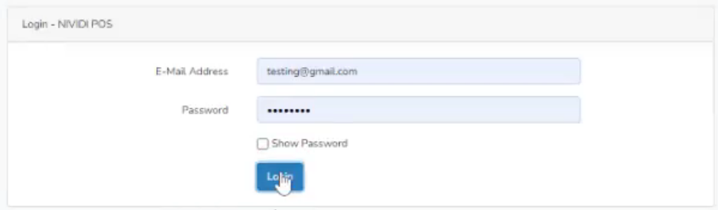
FEATURES OF THIS SYSTEM
USER LOGIN
7

Slide 12
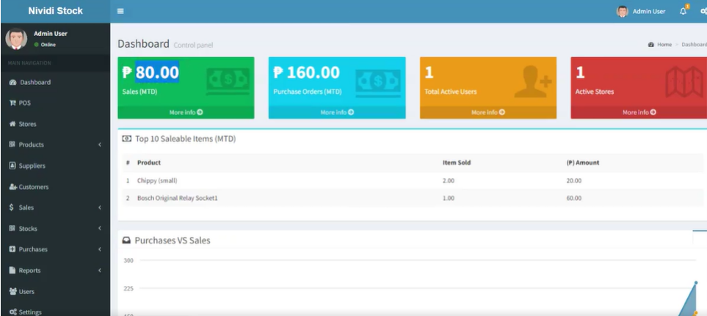
FEATURES OF THIS SYSTEM
8

Slide 13
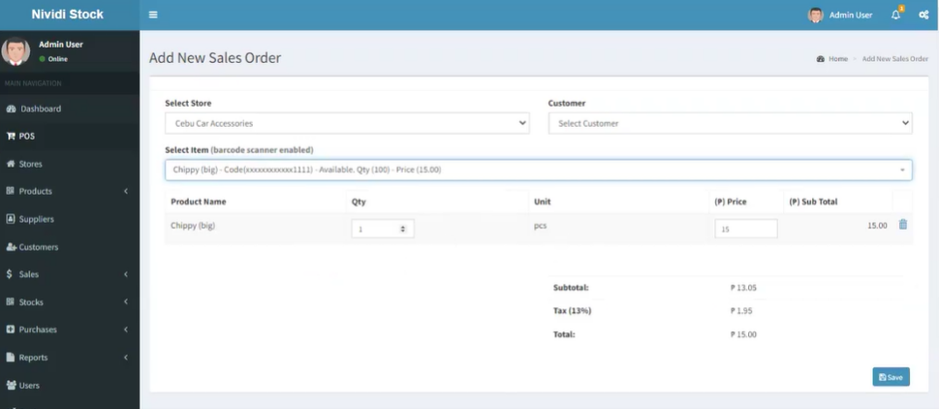
POS
9

Slide 14
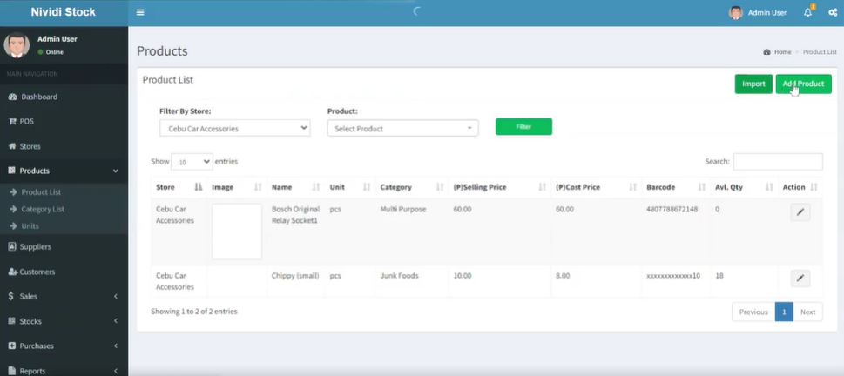
MENU PAGE
10

Slide 15
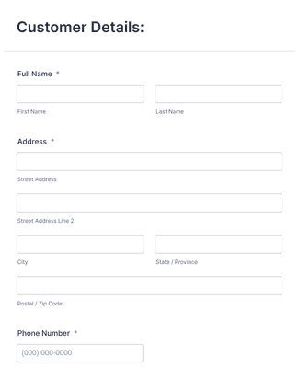
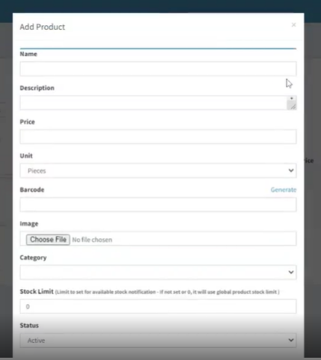
CUSTOMER’S POP UP DIALOG BOX
11

Slide 16
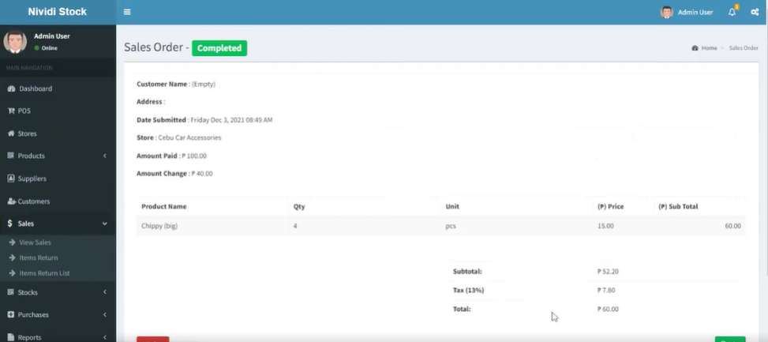
SALES
9

Slide 17
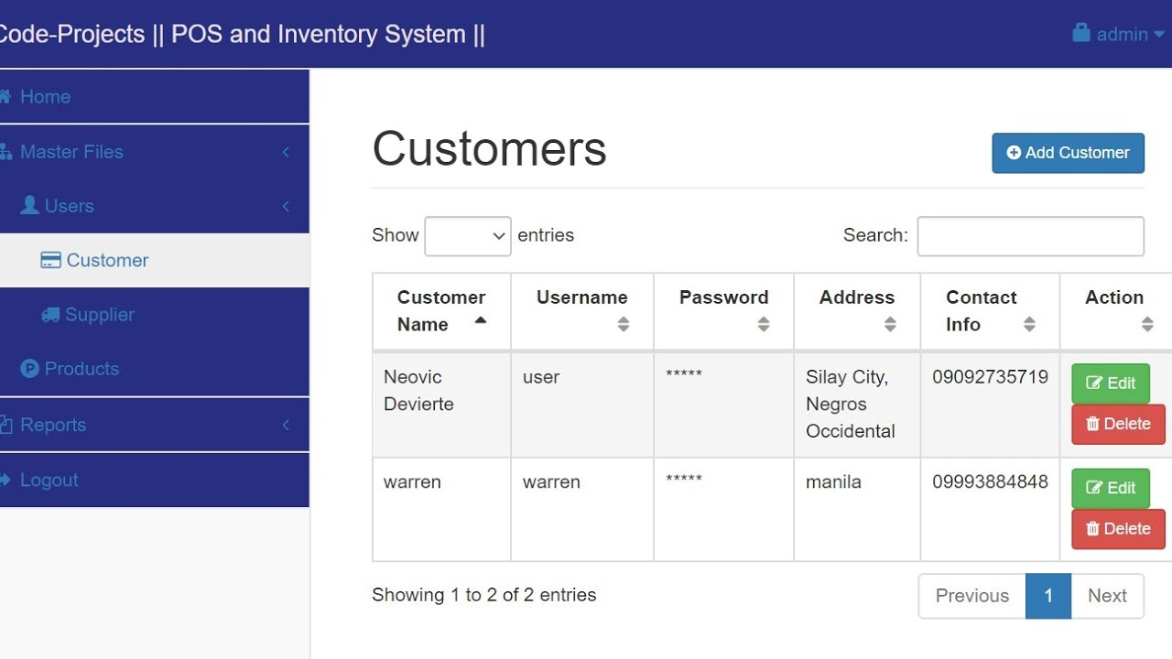
USERS
10

Slide 18
THAT’S ALL THANK YOU!!! :))

